Slide 1
Feature Selection
Jaya Sil

Slide 2
Importance of Feature Selection
Feature selection is the process of reducing the number of input variables when developing a predictive model.
It enables the machine learning algorithm to train the dataset faster.
It reduces the complexity of a model and makes it easier to interpret.
It improves the accuracy of a model if the right subset is chosen.
It reduces overfitting.

Slide 3
Methods of Feature Selection
The goal of feature selection in machine learning is to find the best set of features that allows one to build useful models.
Filter based: Filter methods measure the relevance of features by specifying some metric. An example of such a metric could be correlation/chi-square.
Wrapper-based: We use a subset of features and train a model. Based on the inferences, we decide to add or remove features from your subset. The problem is essentially reduced to a search problem. Example: Recursive Feature Elimination.
Embedded: Embedded methods use algorithms that have built-in feature selection methods. For instance, Lasso and Random Forest have their own feature selection methods.

Slide 4
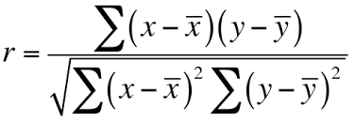
Filter based
We check the absolute value of the Pearson’s correlation between the target and numerical features in the
We keep the top n features based on this criterion.
Chi-Squared is another filter-based method, for categorical features in a dataset.
We calculate the chi-square metric between the target and the input variable and only select the variable with the maximum chi-squared values.

Slide 5
Wrapper Methods
Wrappers require some method to search the space of all possible subsets of features, assessing their quality by learning and evaluating a classifier with that feature subset.
The feature selection process is based on a specific machine learning algorithm that we are trying to fit on a given dataset.
It follows a greedy search approach by evaluating all the possible combinations of features against the evaluation criterion.
The wrapper methods usually result in better predictive accuracy than filter methods.

Slide 6
Wrapper Methods
Forward Selection: An iterative method, start with having no feature in the model. In each iteration, we keep adding the feature which best improves the model till an addition of a new feature does not improve the performance of the model.
Backward Elimination: Start with all the features and removes the least significant feature at each iteration which improves the performance of the model. Repeat this until no improvement is observed on removal of features.
Recursive Feature elimination: It is a greedy optimization algorithm aims to find the best performing feature subset by repeatedly createing the models and keeps aside the best or the worst performing feature at each iteration. It constructs the next model with the left features until all the features are exhausted. Ranks the features based on the order of their elimination.

Slide 7
Difference between Filter and Wrapper
Wrapper methods measure the usefulness of a subset of feature by actually training a model on it.
Filter methods are much faster compared to wrapper methods as they do not involve training the models. On the other hand, wrapper methods are computationally very expensive as well.
Filter methods use statistical methods for evaluation of a subset of features while wrapper methods use cross validation.
Using the subset of features from the wrapper methods make the model more prone to overfitting as compared to using subset of features from the filter methods
Wrapper methods can always provide the best subset of features.

Slide 8
Information Gain
Entropy is a way to measure impurity
Entropy = - Σ_{i} p_{i} log₂ p_{i} ; p_{i} is the probability of class i
The higher the entropy the more the information content.
We want to determine which attribute in a given set of training feature vectors is most useful for discriminating between the classes to be learned.
Information gain tells us how important a given attribute of the feature vectors is.

Slide 9
^{Information Gain}
Information gain calculates the reduction in entropy from the transformation of a dataset.
It can be used for feature selection by evaluating the Information gain of each variable in the context of the target variable.
Fisher score is one of the most widely used supervised feature selection methods.
The algorithm returns the ranks of the variables based on the fisher’s score in descending order.
Information Gain = entropy(parent) – [average entropy(children)]

Slide 15
Embedded methods
Embedded methods combine the qualities’ of filter and wrapper methods by including interactions of features but also maintaining reasonable computational cost.
It’s implemented by algorithms that have their own built-in feature selection methods.
Some of the most popular examples of these methods are LASSO and RIDGE regression which have inbuilt penalization functions to reduce overfitting.
Lasso regression performs L1 regularization which adds penalty equivalent to absolute value of the magnitude of coefficients.
Ridge regression performs L2 regularization which adds penalty equivalent to square of the magnitude of coefficients.

Slide 16
Embedded Methods
Embedded methods are iterative in the sense that takes care of each iteration of the model training process and carefully extracts those features which contribute the most to the training for a particular iteration.
LASSO Regularization (L1)
Regularization consists of adding a penalty to the different parameters of the machine learning model to reduce the freedom of the model, i.e. to avoid over-fitting.
In linear model regularization, the penalty is applied over the coefficients that multiply each of the predictors.
From the different types of regularization, Lasso or L1 has the property that is able to shrink some of the coefficients to zero. Therefore, that feature can be removed from the model.

Slide 17
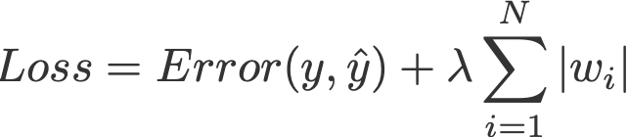
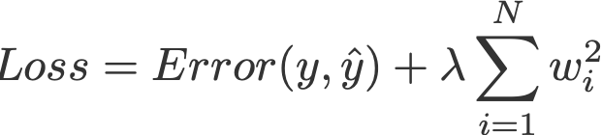
Regularisation
Regularisation is a process of introducing additional information in order to prevent overfitting.
A linear regression model that implements L1 norm for regularisation is called lasso regression, and one that implements (squared) L2 norm for regularisation is called ridge regression.

Slide 18
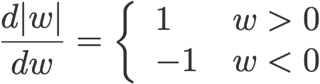
The regularisation parameter
The regularisation parameter λ > 0 is manually tuned.
|w| is differentiable everywhere except when w=0
Similarly, adding an L2 regularisation term where again, λ > 0.

Slide 19
Deep learning
Deep learning mimics the workings of the human brain in processing data for use in detecting objects, recognizing speech, translating languages, and making decisions.
Deep learning is able to learn without human supervision, drawing from data that is both unstructured and unlabeled.
Deep learning achieves recognition accuracy at higher levels than ever before.
Deep learning requires large amounts of labeled data.
Deep learning requires substantial computing power. High-performance GPUs

Slide 20
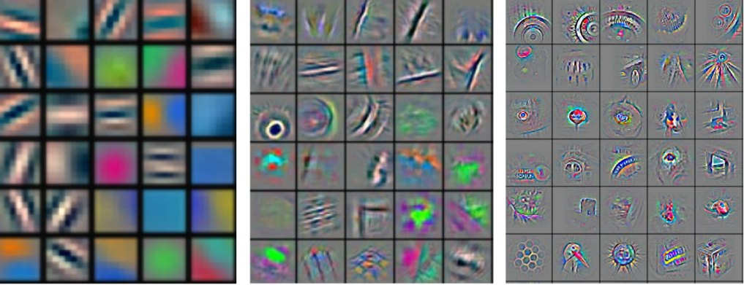
Deep learning
With deep learning, one can start with raw data as features will be automatically created by the neural network when it learns.
A deep learning system is a fully trainable system beginning from raw input, to the final output of recognized objects.

Slide 21
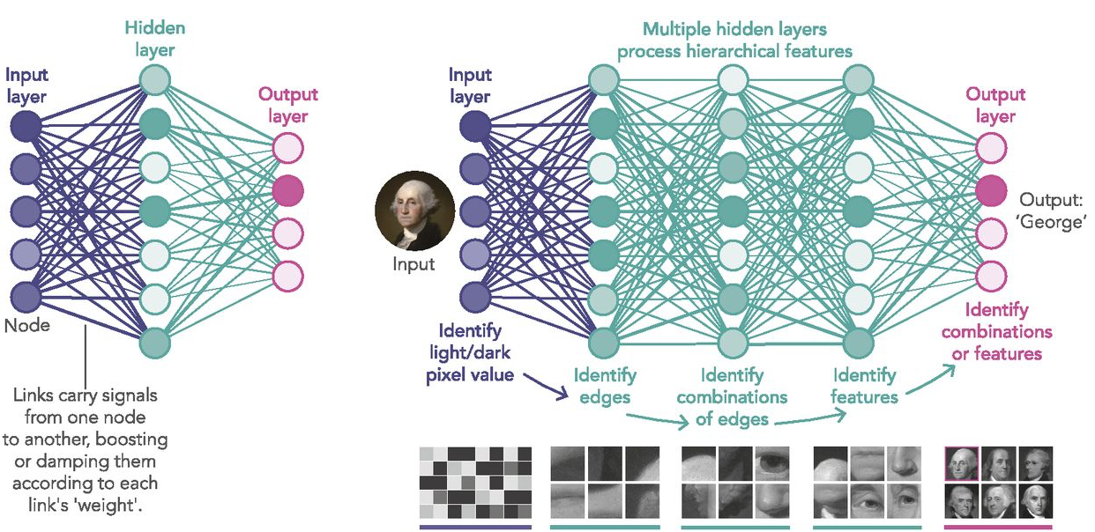

Slide 22
Feature Engineering and Feature Learning
Deep learning has yielded results by learning features and feature hierarchies.
The outstanding performance of deep learning algorithms with complex tasks requiring huge amounts of data.
Increasing availability of pre-trained models on publicly available data, have made deep learning particularly appealing to many organizations in the past few years.
Deep learning algorithms are able to learn hidden patterns from the data by themselves, combine them together, and build much more efficient decision rules.

Slide 23
Decision Tree
Decision tree is the most powerful and popular tool for classification and prediction.
Decision trees are able to generate understandable rules.
Decision trees are able to handle both continuous and categorical variables.

Slide 24
Decision Tree
A Decision Tree is constructed by asking a series of carefully crafted questions about the attributes of the test record.
Each time an answer is received, a follow-up question is asked until it is a conclusion about the class label of the record.
The series of questions and their possible answers can be organised in the form of a decision tree, which is a hierarchical structure consisting of nodes and directed edges.
The non-terminal nodes, i.e. the root and other internal nodes, contain attribute test conditions to separate records that have different characteristics.
Leaf or terminal nodes, where each leaf node is assigned to a class label.

Slide 25
Construction of Decision Tree
A tree can be “learned” by splitting the source set into subsets based on an attribute value test.
This process is repeated on each derived subset in a recursive manner called recursive partitioning.
The recursion is completed when the subset at a node all has the same value of the target variable, or when splitting no longer adds value to the predictions.
The construction of decision tree classifier does not require any domain knowledge or parameter setting, and therefore is appropriate for exploratory knowledge discovery.

Slide 26
Decision Tree
Commonly known as divide and conquer because it splits the data into subsets, which are then split repeatedly into even smaller subsets, and so on and so forth until the process stops.
Some of the trees are more accurate than others, finding the optimal tree is computationally infeasible because of the exponential size of the search space.
Hunt's algorithm, ID3, C4.5, CART, SPRINT are greedy decision tree induction algorithms to construct decision tree.

Slide 27
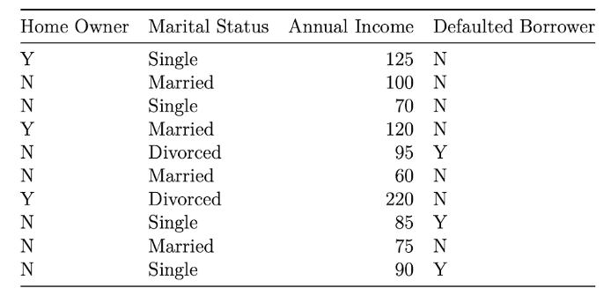
Construct a Decision Tree
target attribute or class label
To construct the decision tree using this dataset, we begin with the target attribute Defaulted Borrower

Slide 28
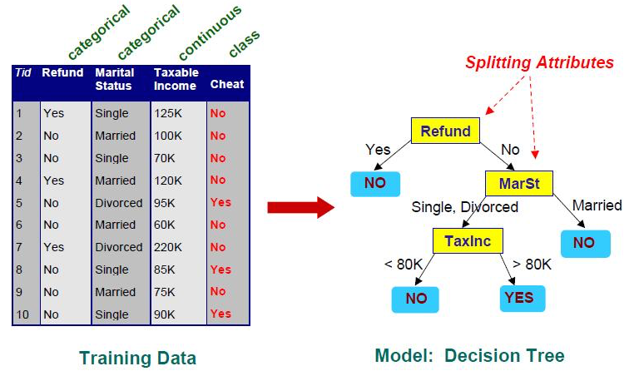
Training Data for predictin whether the person cheats

Slide 29
Classification/Prediction
After construction of the decision tree a test record is classified.
Starting from the root node, we apply the test condition to the record and follow the appropriate branch based on the outcome of the test.
It then led us either to another internal node, for which a new test condition is applied, or to a leaf node.
When we reach the leaf node, the class lable associated with the leaf node is then assigned to the record.

Slide 30
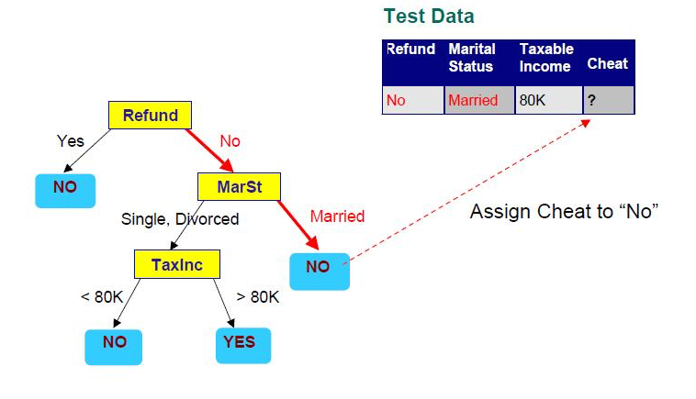

Slide 31
Decision Tree Classifier
We start at the tree root and split the data on the feature that results in the largest information gain (IG) (reduction in uncertainty towards the final decision).
In an iterative process, repeat this splitting procedure at each child node until the leaves are pure, means that the samples at each leaf node all belong to the same class.
In practice, we may set a limit on the depth of the tree to prevent overfitting.
We compromise on purity here somewhat as the final leaves may still have some impurity.

Slide 32
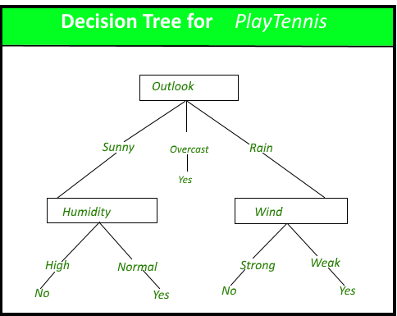
The decision tree classifies a particular morning according to whether it is suitable for playing tennis and returning the classification associated with the particular leaf (Yes or No).
For example, the instance
(Outlook = Rain,
Temperature = Hot,
Humidity = High,
Wind = Strong )

Slide 33
Decision Tree Representation
Decision trees classify instances by sorting them down the tree from the root to some leaf node, which provides the classification of the instance.
An instance is classified by starting at the root node of the tree, testing the attribute specified by this node,then moving down the tree branch corresponding to the value of the attribute as shown in the above figure.
This process is then repeated for the subtree rooted at the new node.

Slide 34
Algorithm be represented as a tree
A decision tree is drawn upside down with its root at the top.
In the image on the left, the bold text in black represents a condition/internal node, based on which the tree splits into branches/ edges.
The end of the branch that doesn’t split anymore is the decision/leaf.
Growing a tree involves deciding on which features to choose and what conditions to use for splitting, along with knowing when to stop.

Slide 35
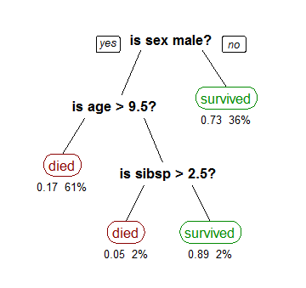
Consider the titanic data set for predicting whether a passenger will survive or not.
features/attributes/columns from the data set, namely sex, age and sibsp (number of spouses or children along).

Slide 36
In the first split or the root, all attributes/features are considered and the training data is divided into groups based on this split.
We have 3 features, so will have 3 candidate splits.
Now we will calculate how much accuracy each split will cost us, using a function.
The split that costs least is chosen, which in our example is sex of the passenger.
This algorithm is recursive in nature as the groups formed can be sub-divided using same strategy.
Due to this procedure, this algorithm is also known as the greedy algorithm, as we have an excessive desire of lowering the cost.
This makes the root node as best predictor/classifier.

Slide 37
Classification and Regression Trees
This methodology is more commonly known as learning decision tree from data and above tree is called Classification tree as the target is to classify passenger as survived or died.
Regression trees are represented in the same manner, just they predict continuous values like price of a house.
In general, Decision Tree algorithms are referred to as CART or Classification and Regression Trees.

Slide 38
Pruning
pruning involves removing the branches that make use of features having low importance.
We reduce the complexity of tree, and thus increasing its predictive power by reducing overfitting.
Pruning can start at either root or the leaves.
The simplest method of pruning starts at leaves and removes each node with most popular class in that leaf, this change is kept if it doesn't deteriorate accuracy.

Slide 39
Its also called reduced error pruning.
More sophisticated pruning methods can be used such as cost complexity pruning where a learning parameter (alpha) is used to weigh whether nodes can be removed based on the size of the sub-tree.
This is also known as weakest link pruning.

Slide 40
The weaknesses of decision tree methods
Decision trees are less appropriate for estimation tasks where the goal is to predict the value of a continuous attribute.
Decision trees are prone to errors in classification problems with many class and relatively small number of training examples.
Decision tree can be computationally expensive to train.
At each node, each candidate splitting field must be sorted before its best split can be found.
In some algorithms, combinations of fields are used and a search must be made for optimal combining weights.
Pruning algorithms can also be expensive since many candidate sub-trees must be formed and compared.

Slide 41
Random Forest
Random forest is a supervised learning algorithm. The "forest" it builds, is an ensemble of decision trees.
Random forest builds multiple decision trees and merges them together to get a more accurate and stable prediction.
Random forest can be used for both classification and regression problems.
Each individual tree in the random forest spits out a class prediction and the class with the most votes becomes our model’s prediction.

Slide 42
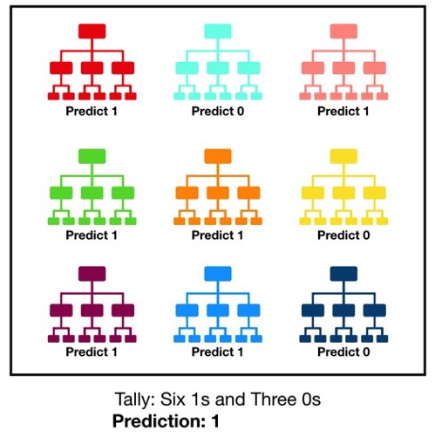

Slide 43
Random forest - bagging
Decisions trees are very sensitive to the training data
Random forest takes advantage of this by allowing each individual tree to randomly sample from the dataset with replacement, resulting in different trees.
This process is known as bagging.
It uses bagging and feature randomness when building each individual tree to try to create an uncorrelated forest of trees whose prediction by committee is more accurate than that of any individual tree.

Slide 44
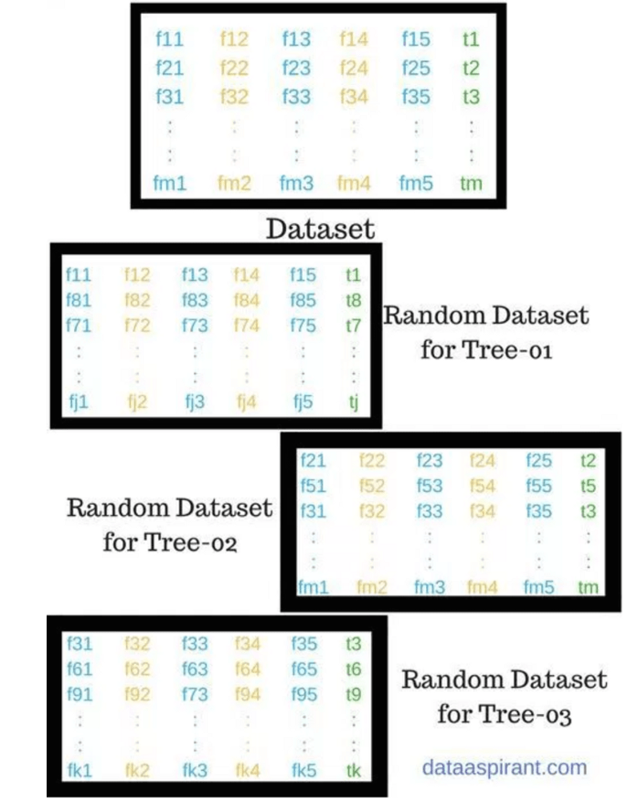
Randomly select “K” features
from total “m” features
where K << m

Slide 45
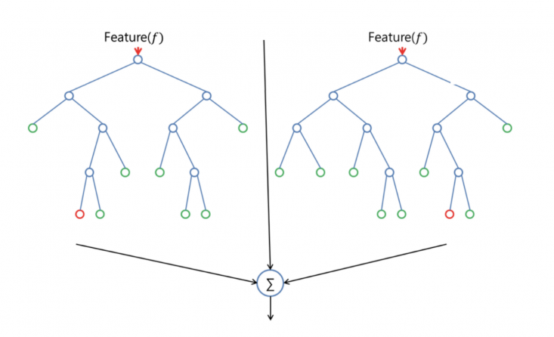
The Random Forest

Slide 46
Limitation of Random Forest
The main limitation of random forest is that a large number of trees can make the algorithm too slow and ineffective for real-time predictions.
In general, these algorithms are fast to train, but quite slow to create predictions after trained.
A more accurate prediction requires more trees, which results in a slower model.
In most real-world applications, the random forest algorithm is fast enough but there can certainly be situations where run-time performance is important and other approaches would be preferred.

